Slide 1
Bike Sharing Demand Analysis
Next Hikes IT Solutions
Internship Project
Bindu Kale A

Slide 2
Project Tasks
1. Excel Foundations & Data Handling
2. Data Loading, Merging & Cleaning
3. Conditional Logic & Lookup Functions
4. Advanced Data Analysis
5. Data Visualization & Business Intelligence

Slide 3
DATASET-1
In the dataset-1, the excel sheet had columns that included instant, dteday, season, yr, month, hr, holiday, weekday, weather sit, temp.
Before analyzing, the data was cleaned, formatted and well structured. According to the data I have removed season and yr column and added Days (Sunday, Monday, Tuesday, Wednesday, Thursday, Friday, Saturday) and weather (Cloudy, Light rain, Heavy rain, Extreme weather) column using ‘IF’ functions for the convenience to analyze the data.
I have checked for missing values, wrong values, removed duplicate data. There were no missing values or duplicates in the dataset-1.
I have bolded the headers, applied filters- which helps to see only the desired rows and made sure columns have correct format, have sorted the data, for e.g. Sorted the temp data from smallest value to largest value.

Slide 4
I have used basic formulas like Sum to calculate instant, hr. Average to calculate hr, weekday, weathersit, temp. Count for weekday and have used Len function for weather, which helped ensured everything was consistent. For e.g.,
To highlight the important information, I have applied conditional formatting for hr, temp, weathersit using Highlight cell rules and color scales. For e.g. temp- greater than 0.20 highlighted in red, etc.
Once the data is cleaned and organized, I have created pivot table and pivot chart to summarize, analyze and visualize the data quickly and easily.
The tables that were created contains variables like hr vs temp, hr vs weather, weather vs total hr, hr vs days.
SUM
7195
AVERAGE
11.79508

Slide 6
DATASET-2
Similar steps were applied in the dataset-2, the excel sheet had columns that included unnamed, instant, atemp, hum, windspeed, casual, registered, cnt.
Before analyzing, the data was cleaned, formatted and well structured. As the column ‘unnamed’ was irrelevant, I have removed it.
I have bolded the headers, applied filters- which helps to see only the desired rows and made sure columns have correct format (for e.g, have increased the decimals by 4 digits in atemp)
There were no duplicates or wrong values in the dataset-2. But there were a few missing values/ blanks in atemp. I have taken the average value of atemp column and the results has been replaced in the blank cells.

Slide 7
I have sorted the data, for e.g. Sorted the instant data from largest value to smallest value.
I have used basic formulas like Sum to calculate casual, registered, cnt. Average to calculate atemp, hum , windspeed, casual, registered, cnt
To highlight the important information, I have applied conditional formatting for windspeed and cnt using Highlight cell rules and color scales, For e.g. cnt greater than 150 highlighted in green, etc.
Once the data is cleaned and organized, I have created pivot table and pivot chart to summarize, analyze and visualize the data quickly and easily for Dataset-2.
The tables that were created contains variables like atemp vs renatls, hum vs rentals, windspeed vs casual users.

Slide 9
DATASET-3
In the dataset-3, the excel sheet had all the columns that were present in dataset-1 and dataset-2.
And accordingly I have formatted, cleaned and organized the columns in dataset-3.
I have checked for missing values, wrong values, removed duplicate data, have bolded the headers, applied filters- which helps to see only the desired rows and made sure columns have correct format, have sorted the data.
Basic formulas like Sum, Average, Count and text functions are also applied in dataset-3 to the same columns in dataset-1 and dataset-2.

Slide 10
Have highlighted the important information, correspondingly to dataset-1 and dataset-2 and have applied conditional formatting as well.
Once the data is cleaned and organized, I have created pivot table and pivot chart to summarize, analyze and visualize the data quickly and easily.
The tables that were created contains variables like hr vs cnt, weather vs cnt, registered users vs days.

Slide 12
DATASET-A
Dataset A is the merged version of Dataset-1 and Dataset- 2, I have imported all the columns from Dataset-1 and Dataset-2 to create a new sheet and named it Dataset-A.
It was necessary to combine the data to get the complete description of the bike rentals records from both the data sheet.
I have used VLOOKUP formula to bring the columns with common keywords like instant, hr, dteday, month of Dataset-2 together with Dataset-1 which were copied to a new excel sheet and merged with them.
In Dataset-A, we have columns like- instant, dteday, month, hr, holiday, weekday, Days, weathersit, Weather, temp, atemp, hum, windspeed, casual, registered, cnt. By merging them, I got all the details in one row.

Slide 13
And accordingly I have formatted, cleaned and organized the columns in dataset-A, similar to Dataset-1 and Dataset-2.
I have checked for missing values, wrong values, and duplicate data or inconsistent data. Have bolded the headers, applied filters and made sure columns have correct format as the original datasets.
I have also crosschecked the sum of cnt using the SUM formula, if it matched the sum from dataset-2.
Once the data is cleaned and organized, I have created pivot table and pivot chart to summarize, analyze and visualize the data quickly and easily.
The tables that were created contains variables like windspeed vs rentals atemp vs temp.

Slide 14
DATASET-FINAL
After merging Dataset-1 and Dataset-2 to create Dataset-A, Dataset- FINAL was created by merging Dataset-A and Dataset-3. Dataset-Final had all the relevant data from separate datasets, i.e., Dataset-1, Dataset-2, Dataset-3, containing different variables and extra rows.
By merging these data, I got the complete information of the bike rentals records from all the data sheet which helped to perform statistical analysis, identify patterns and trends and to maintain consistent and accurate data.
In Dataset-FINAL, along with the columns like- instant, dteday, month, hr, holiday, weekday, Days, weathersit, Weather, temp, atemp, hum, windspeed, casual, registered, cnt. I have added few more columns for interpreting the analysis easier like classification, correct count and demand rate.

Slide 15
I have copied the rows from Dataset-3 and pasted with the copy of Dataset-A sheet, to create Dataset-Final.
After this, I have checked for missing values, wrong values, and duplicate data, blanks and inconsistent data. Have bolded the headers, applied filters and made sure columns have correct format as the original datasets.
Here to the columns like demand rate and classification, I have used the IF formula to extract the details. (E.g., =IF(OR(G1001="Saturday", G1001="Sunday"), "Weekend", "Weekday") and =IF(Q997>100, "High Demand", "Low Demand")) to know whether the holiday is weekday or weekend and if the demand for bike rentals is high or low.
Once the data is cleaned and organized, I have created pivot table and pivot chart to summarize, analyze and visualize the data quickly and easily.
The tables that were created contains variables like-

Slide 16
Time vs cnt- Shows how bike rentals change over time, helps identify peak rental hours during the day.
Weather vs cnt- Analyzes how weather conditions affect bike usage and helps understand whether people rent more bikes during cloudy or extreme weather.
Usertype (Casual vs Registered)- This helps understand who uses the bikes more.
Hour vs Usertype- Shows when casual and registered users rent bikes.
Bike Rentals by Days- Shows bike usage across different days of the week.
Heatmap (Hr by Days)- It shows high demand times during the week.

Slide 17
Rentals vs Hum- Shows whether high humidity affects bike rentals.
Rentals vs Windspeed- Analyzes if strong winds reduce bike usage.
Weather vs Hr- Helps understand how weather conditions influence hourly rentals.
Days vs Registered Users- Shows which days registered users ride the most. It helps understand the daily commuting patterns.
I have also grouped and aggregated the data to simplify the data which helped to get clear summary, to understand, for e.g., weather impact on bike usage.
Functions like COUNTIF were used to count how many time the non-holidays occur, weather condition etc.,

Slide 18
SUMIF to add values based on days, hr and temp.
STDEV function was applied to measure how the rental data varied with hum, windspeed, etc.
And CORREL which is used to find the relationship between two variables was applied to check how temp, time, or windspeed affected the bike rentals.
A interactive dashboard was created by combining all the Pivot Charts that was created in Dataset-FINAL, like, line charts, column charts, pie charts, heatmaps. It was created to make the visualization easy and highlight the important patterns in Bike Sharing Demand Analysis.
I have added slicers to days, windspeed, hr, hum, temp, weather and timeline to allow the dynamic filtering of the data.

Slide 19
CORREL BETWEEN TEMPERATURE AND RENTALS
The correlation between temperature and bike rentals is 0.2292. There is a weak relationship between temperature and bike rentals, as 0.2292 is close to 0.
This shows when temperature increases, bike rentals may slightly increase. This shows that temperature alone does not strongly determine bike demand.

Slide 20
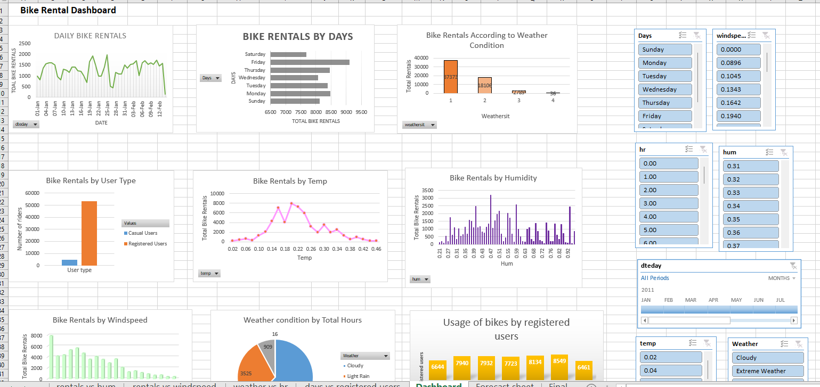
Overall Image of the Dynamic Dashboard

Slide 21
In the end advanced tools like Forecast sheet was created to analyze the dataset along with Anomaly Detection, which helped to identify the future trend in bike rentals and detect the unusual patterns.
The average of the forecast cnt is 59.30 which is very close to the actual rentals cnt.
From the graph, we can say that, there is consistent rental demand without major increase or decrease.

Slide 22
KPI Dashboard- KPI chart was created to show our visualize our results making it easier to understand and represent key performance indicators such as total rentals, average rentals, user types, etc.,.
By this analysis we can say that bike demand is relatively stable but influenced by variables like weather, days, temp, etc., Registered users drive most of the demand, while casual users increases during favorable conditions.

